Slide 1
Mitigating Effects of Future Pandemics on Disproportionately Affected Populations
GT1
By Michael Hartnett, Yunus Herman, Josh Slizinov

Slide 2
Agenda
GT1
Problem Statement
Solution Proposition
Gathering Data & EDA
Modeling
Model Performance
Improvements
Recommendation
Questions
Problem Statement
Solution Proposition
Gathering Data & EDA
Modeling
Model Performance
Improvements
Recommendation
Questions

Slide 3
Problem
GT1
We've all been affected by COVID this year. However, some groups have been affected more than others. We set out to discover what factors in the socioeconomic and demographic realm may have led this pandemic to disproportionately affect certain groups.
Problem Statement
Solution Proposition
Gathering Data & EDA
Modeling
Model Performance
Improvements
Recommendation
Questions

Slide 4
Problem Statement:
GT1
Can we use socioeconomic, demographic, and employment data to identify groups or clusters most adversely affected by the pandemic in order to properly allocate resources to those areas or groups for both current and future disproportionate effect mitigation?
Problem Statement
Solution Proposition
Gathering Data & EDA
Modeling
Model Performance
Improvements
Recommendation
Questions

Slide 5
Solution Proposition
GT1
Attempt to cluster states based on demographic, socioeconomic, and COVID-19 data to help identify factors that may lead to disproportionate pandemic effects.
Problem Statement
Solution Proposition
Gathering Data & EDA
Modeling
Model Performance
Improvements
Recommendation
Questions

Slide 6
Data Sources
GT1
Bureau of Labor Statistics
John Hopkins University center
CDC.gov
USAFACT
Problem Statement
Solution Proposition
Gathering Data & EDA
Modeling
Model Performance
Improvements
Recommendation
Questions

Slide 7
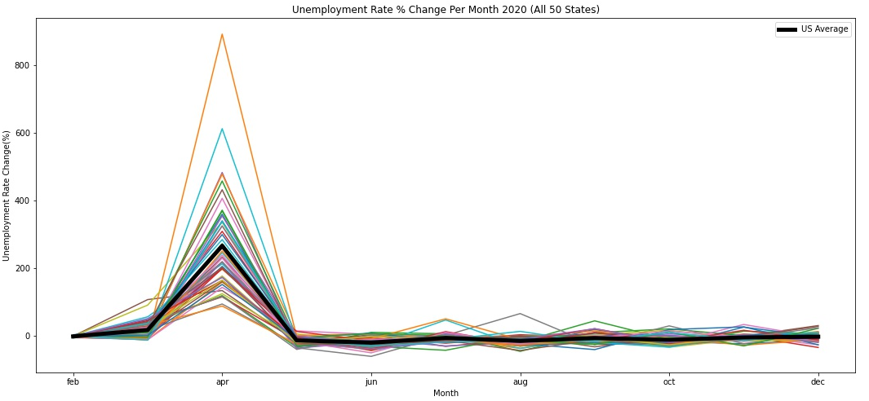
Unemployment EDA
GT1
Percent change MoM better compares states to one another
Use this to better interpret abnormal unemployment rates
Problem Statement
Solution Proposition
Gathering Data & EDA
Modeling
Model Performance
Improvements
Recommendation
Questions

Slide 8
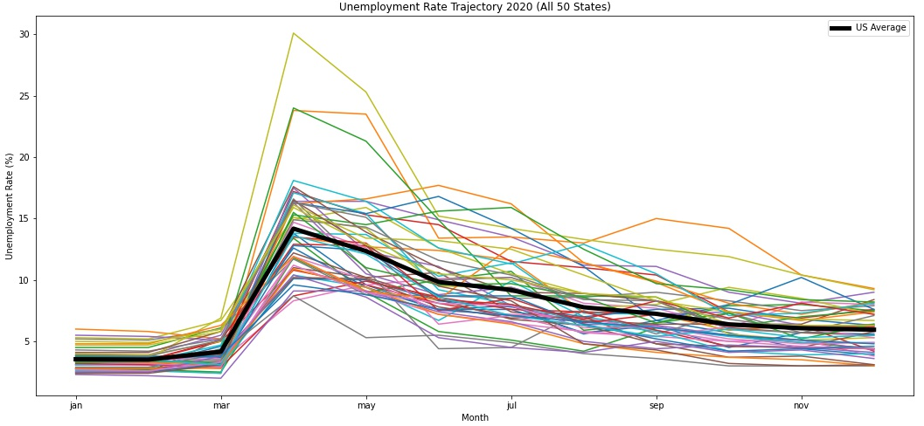
Unemployment EDA
GT1
Several states exhibiting abnormal unemployment compared to the national average
Identify which states exhibited abnormal unemployment
Problem Statement
Solution Proposition
Gathering Data & EDA
Modeling
Model Performance
Improvements
Recommendation
Questions

Slide 9
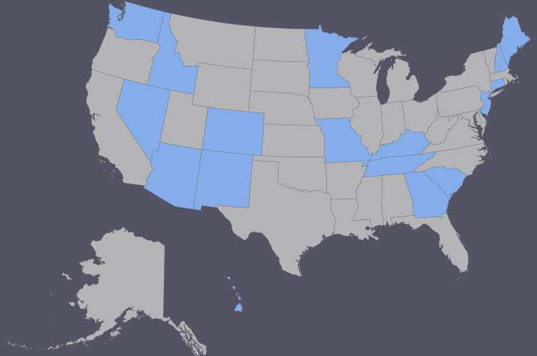
Unemployment EDA
GT1
The following states were determined to have abnormally high unemployment rates in 2020 when compared with the national average:
Arizona
Colorado
Connecticut
Georgia
Hawaii
Idaho
Kentucky
Maine
Minnesota
Missouri
Nevada
New Hampshire
New Jersey
New Mexico
South Carolina
Tennessee
Washington
Problem Statement
Solution Proposition
Gathering Data & EDA
Modeling
Model Performance
Improvements
Recommendation
Questions

Slide 10
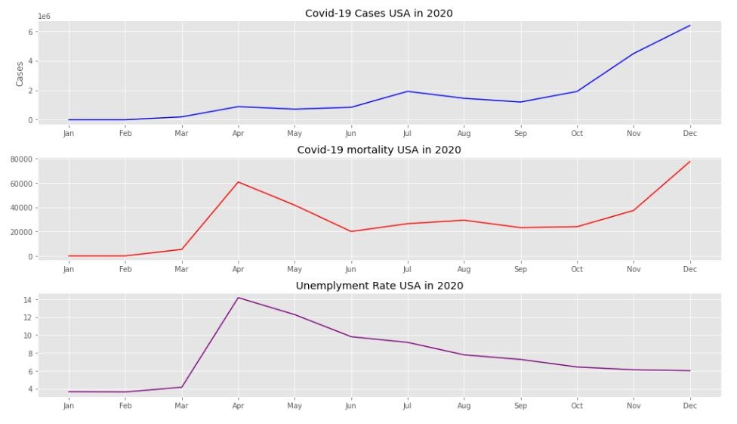
Covid-19 Cases, mortality and Unemployment Rate
GT1
A big spike in both death and unemployment in April
Unemployment line follow mortality covid-19 line until July, then went down when mortality went up
Problem Statement
Solution Proposition
Gathering Data & EDA
Modeling
Model Performance
Improvements
Recommendation
Questions

Slide 11
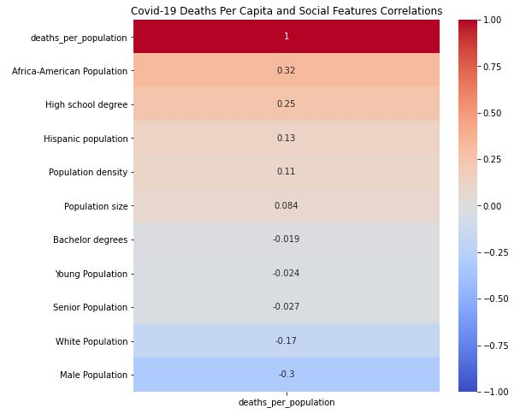
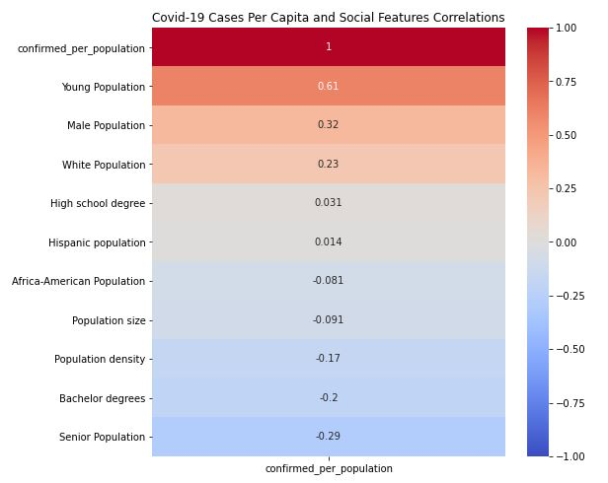
Covid-19 and Demographics
GT1
The deaths per capita heatmap the African-American population measures the highest correlational value of 0.32
The white population correlates negatively with deaths per capita at -0.17
Problem Statement
Solution Proposition
Gathering Data & EDA
Modeling
Model Performance
Improvements
Recommendation
Questions

Slide 12
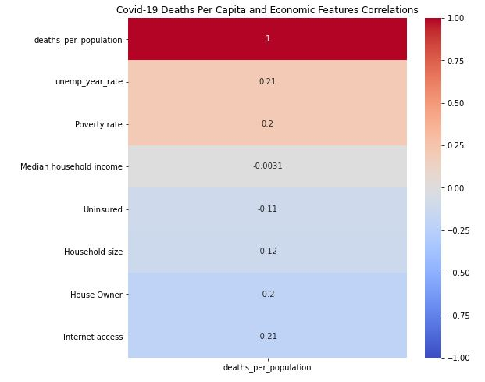
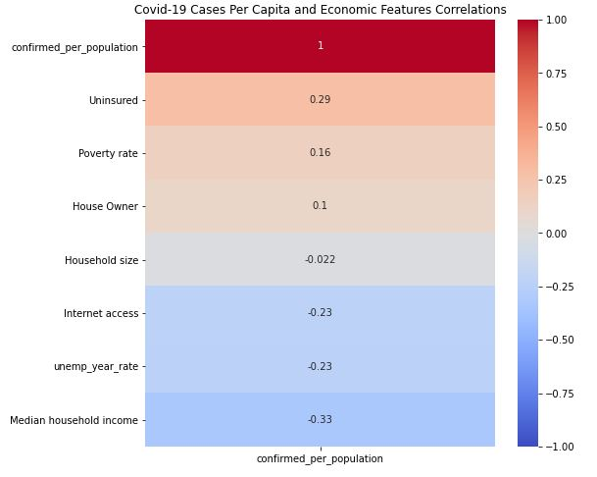
Covid-19 and Economic
GT1
As we can see poverty rate correlates at a rate of 0.2 and 0.16 with deaths and cases respectively
Unemployment rate we see it correlates negatively with confirmed cases (-0.23), but positively with deaths (0.21) - unemployment leads to less cases
Problem Statement
Solution Proposition
Gathering Data & EDA
Modeling
Model Performance
Improvements
Recommendation
Questions

Slide 13
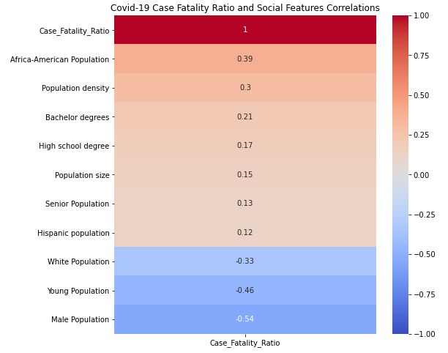
CFR: Case Fatality Ratio
GT1
Number of Deaths from Disease / Number of Confirmed Cases of Disease) * 100
African-American population as the highest correlation amongst features, Hispanic as positive but more moderate, but White population again as negatively correlated
Senior population has positive but young population has significant negative correlation
Problem Statement
Solution Proposition
Gathering Data & EDA
Modeling
Model Performance
Improvements
Recommendation
Questions

Slide 14
Modeling
GT1
DBSCAN is somewhat limited when it comes to clustering observations that may not be overly distinct in separation.
Kmeans is one of the easier methods to understand and other clustering techniques
Using Demographic, Social and Economic features
Problem Statement
Solution Proposition
Gathering Data & EDA
Modeling
Model Performance
Improvements
Recommendation
Questions

Slide 15
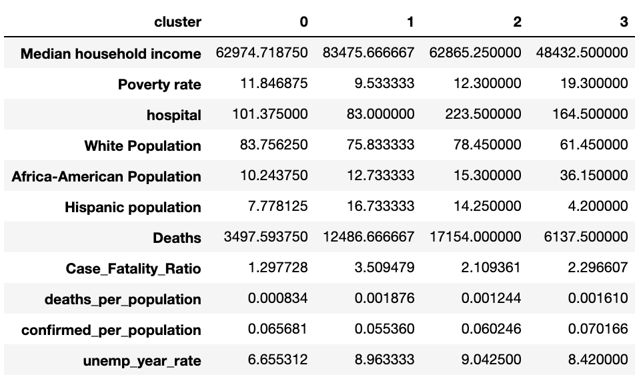
DBSCAN Model Performance
GT1
-Consistent with our EDA we notice that across each cluster, as CFR rises, so do the minority populations
-inversely the white population percentage decreases
-Covid disproportionately affect minority communities at a concerning rate
Problem Statement
Solution Proposition
Gathering Data & EDA
Modeling
Model Performance
Improvements
Recommendation
Questions

Slide 16
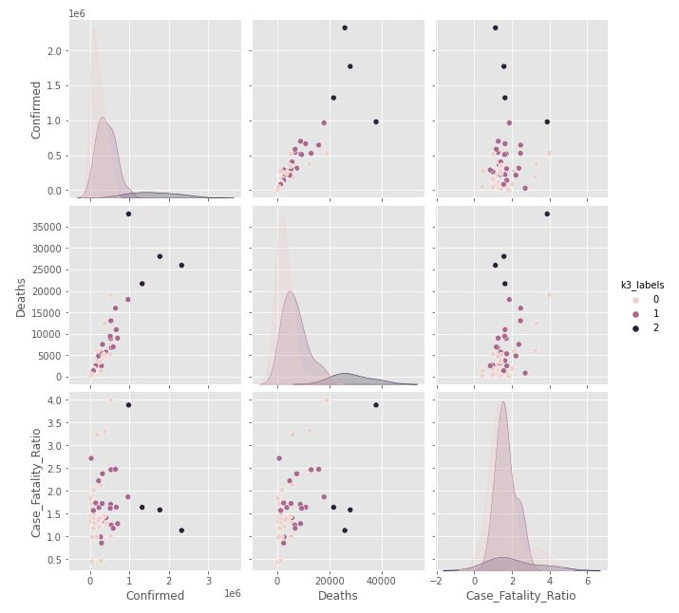
K-Means Model Performance
GT1
3 clusters is the best among 2, 4, 6, 8 and 10 clusters
3 clusters containing 26 states, 21 states, and then 4 states
Problem Statement
Solution Proposition
Gathering Data & EDA
Modeling
Model Performance
Improvements
Recommendation
Questions

Slide 17
Improvements
GT1
Examine data on a lower level (county/city data)
Use more data (data from other pandemics)
Problem Statement
Solution Proposition
Gathering Data & EDA
Modeling
Model Performance
Improvements
Recommendation
Questions

Slide 18
Recommendation
GT1
-We recommend that our audience pay extra attention to the minority demographics when providing aid and resources as they have shown through our data to be the most concerning categories.
-States to closer examine based off models:
Connecticut, Florida, Illinois, Louisiana, Massachusetts, Michigan, Mississippi, New Jersey, Pennsylvania
-For more complete analysis we request access to same data but on a county level, more precise, more defined clusters
Problem Statement
Solution Proposition
Gathering Data & EDA
Modeling
Model Performance
Improvements
Recommendation
Questions

Slide 19
Questions?
GT1
Problem Statement
Solution Proposition
Gathering Data & EDA
Modeling
Model Performance
Improvements
Recommendation
Questions

